Slide 1

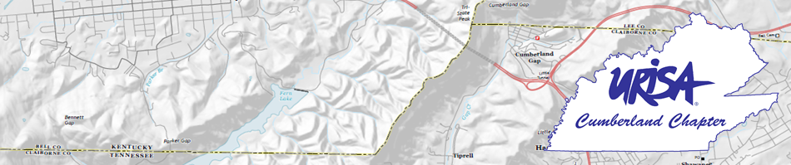
Demetrio P. Zourarakis, Ph.D., GISP, CMS-GIS/LIS, CMS-RS GIS/RS Analyst, Kentucky Division of Geographic Information
OPEN DATA:
Realizing The Essence and Promise of GIS; With Examples from Kentucky and Others
Cumberland Chapter of URISA
2015 Annual Meeting
Friday January 23rd, 2015
Nashville, Tennessee

Slide 2



... In the beginning
Open Government Data Principles
Government data shall be considered open if it is made public in a way that complies with the principles below:
1. Complete All public data is made available. Public data is data that is not subject to valid privacy, security or privilege limitations. 2. Primary Data is as collected at the source, with the highest possible level of granularity, not in aggregate or modified forms. 3. Timely Data is made available as quickly as necessary to preserve the value of the data. 4. Accessible Data is available to the widest range of users for the widest range of purposes. 5. Machine processable Data is reasonably structured to allow automated processing. 6. Non-discriminatory Data is available to anyone, with no requirement of registration. 7. Non-proprietary Data is available in a format over which no entity has exclusive control. 8. License-free Data is not subject to any copyright, patent, trademark or trade secret regulation. Reasonable privacy, security and privilege restrictions may be allowed. Compliance must be reviewable.
The Annotated 8 Principles of Open Government Data
December 7-8, 2007 – Sebastopol, CA
http://opengovdata.org/

Slide 3
... In the beginning (II)
The Open Definition
The Open Definition sets out principles that define “openness” in relation to data and content.
It makes precise the meaning of “open” in the terms “open data” and “open content” and thereby ensures quality and encourages compatibility between different pools of open material.
It can be summed up in the statement that:
“Open means anyone can freely access, use, modify, and share for any purpose (subject, at most, to requirements that preserve provenance and openness).”
Put most succinctly:
“Open data and content can be freely used, modified, and shared by anyone for any purpose”
http://opendefinition.org/

Slide 4

Open Government Directive
http://www.whitehouse.gov/the-press-office/2013/05/09/executive-order-making-open-and-machine-readable-new-default-government-

Slide 5
Sec. 3. Implementation of the Open Data Policy. To facilitate effective Government-wide implementation of the Open Data Policy, I direct the following:
(a) Within 30 days of the issuance of the Open Data Policy, the CIO and CTO shall publish an open online repository of tools and best practices to assist agencies in integrating the Open Data Policy into their operations in furtherance of their missions. The CIO and CTO shall regularly update this online repository as needed to ensure it remains a resource to facilitate the adoption of open data practices.
http://www.whitehouse.gov/the-press-office/2013/05/09/executive-order-making-open-and-machine-readable-new-default-government-

Slide 6

Results (1): Data.gov
https://www.data.gov/

Slide 7
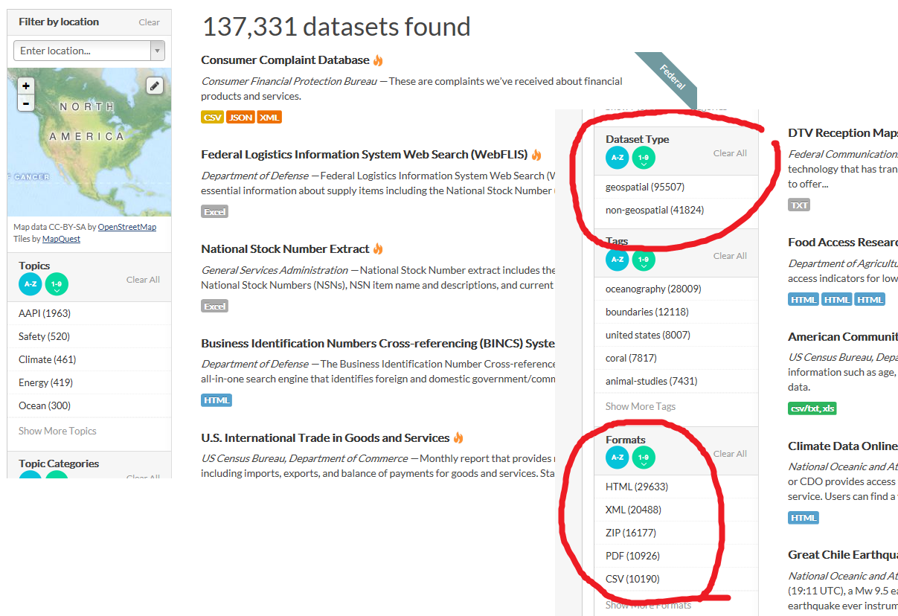
http://catalog.data.gov/dataset#

Slide 8
Results (2): ArcGIS Open Data
Data Driven Detroit (D3)
Maryland iMAP
https://opendata.arcgis.com/about

Slide 9
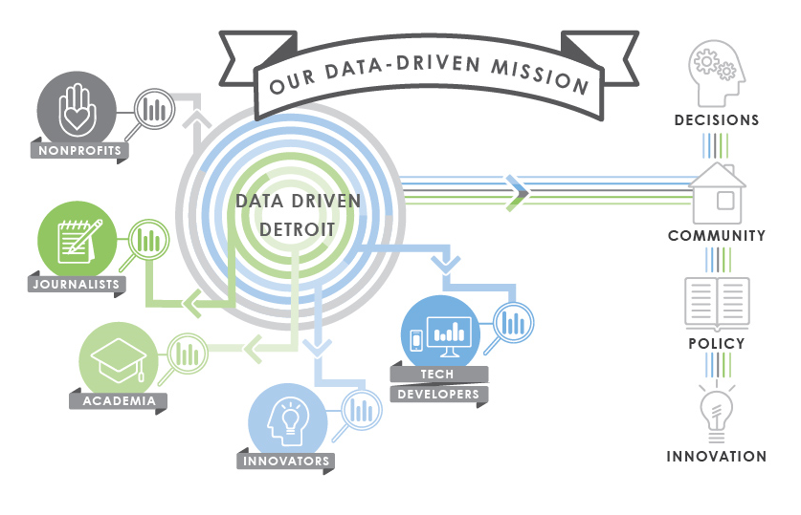

http://d3.d3.opendata.arcgis.com/

Slide 10
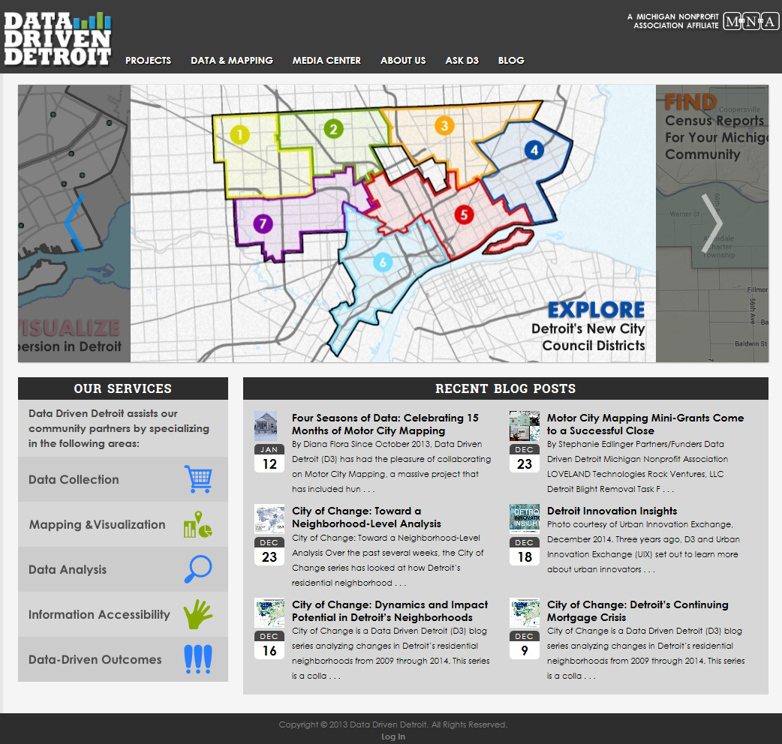

Slide 11
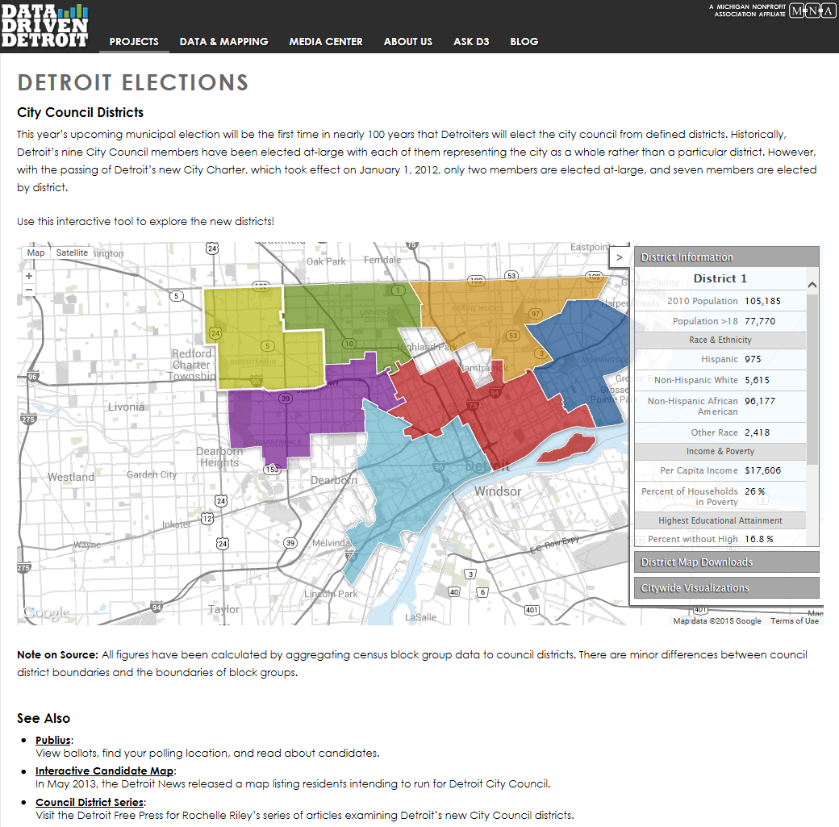

Slide 12
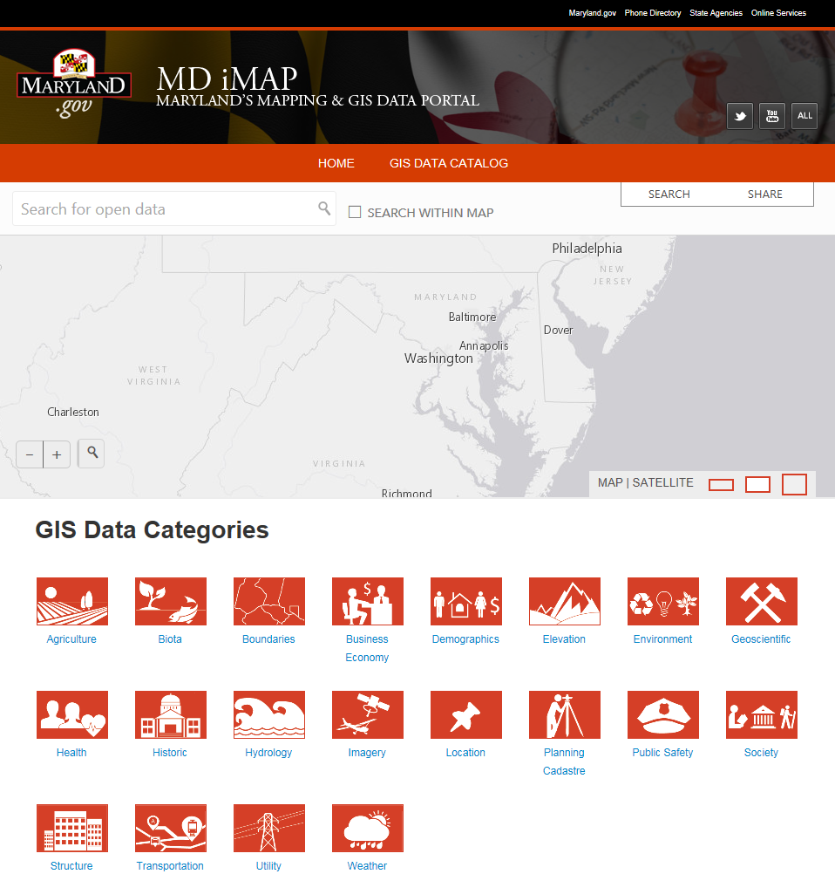
http://imap.maryland.opendata.arcgis.com/

Slide 13
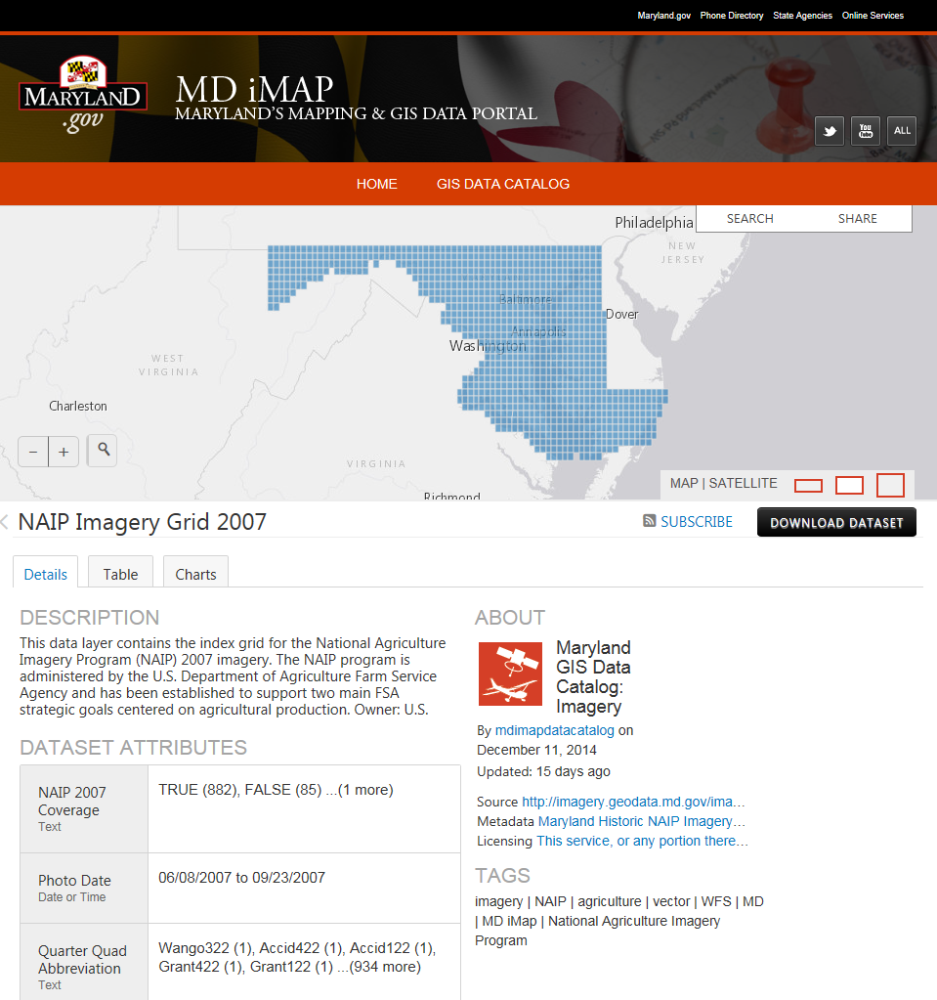

Slide 14
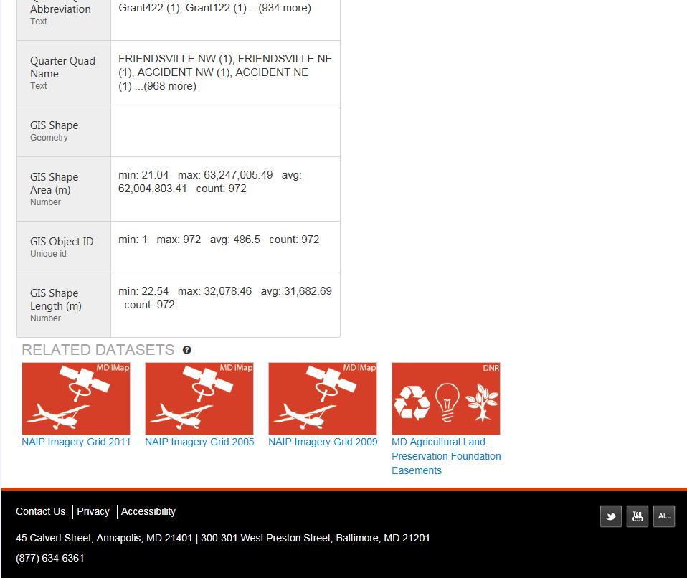

Slide 15
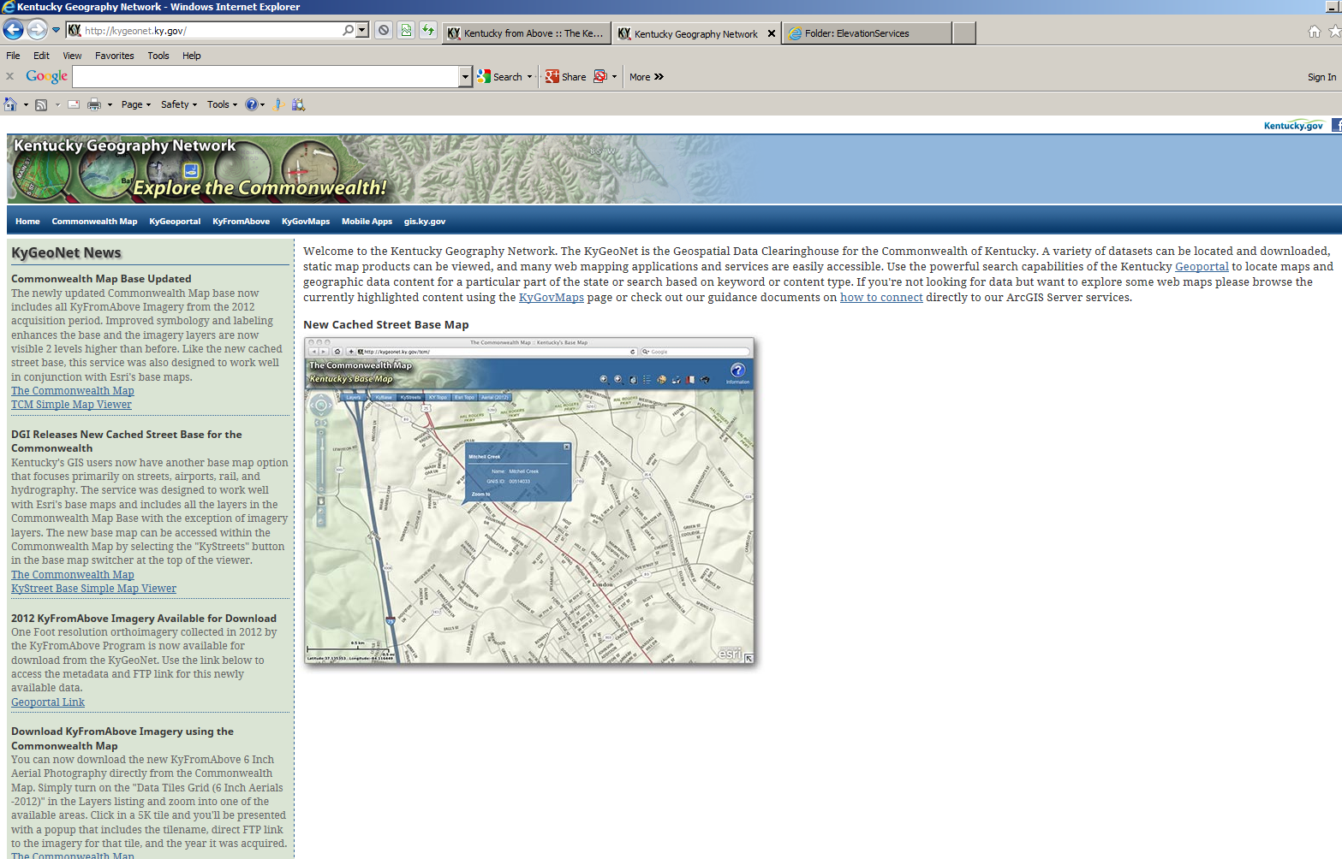
http://kygeonet.ky.gov/

Slide 16
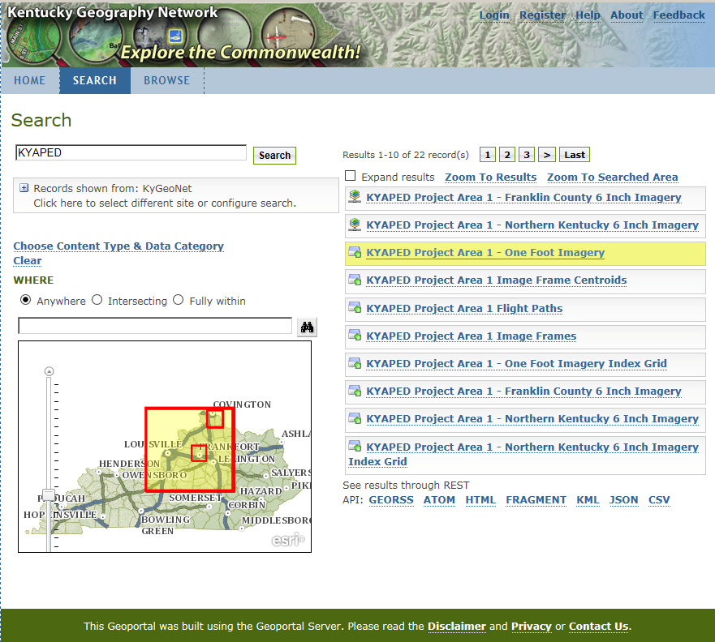
http://kygisserver.ky.gov/geoportal/catalog/main/home.page

Slide 17
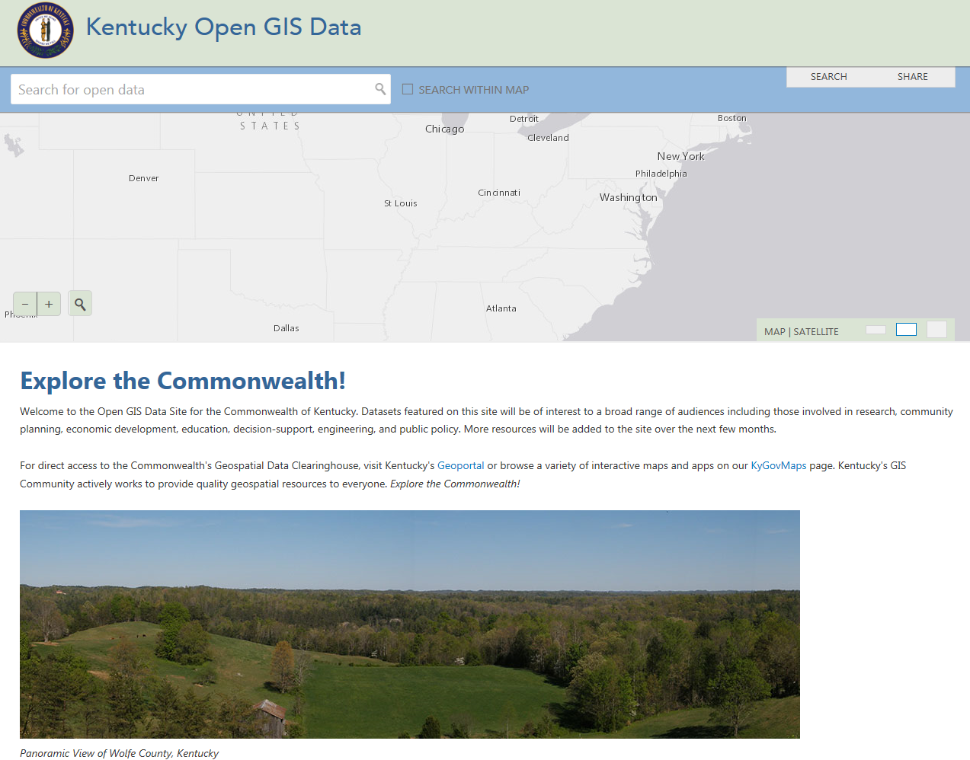
http://kygovmaps.kygeonet.opendata.arcgis.com/

Slide 18
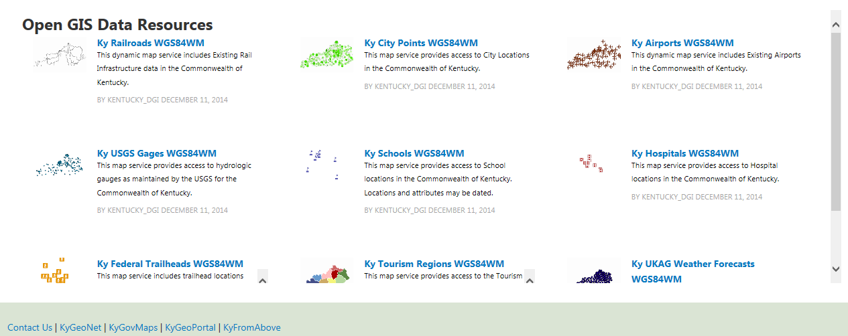
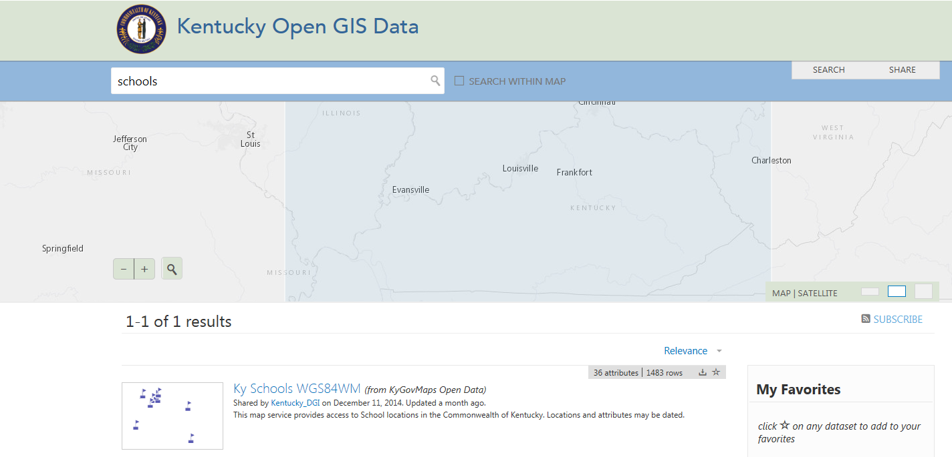

Slide 19
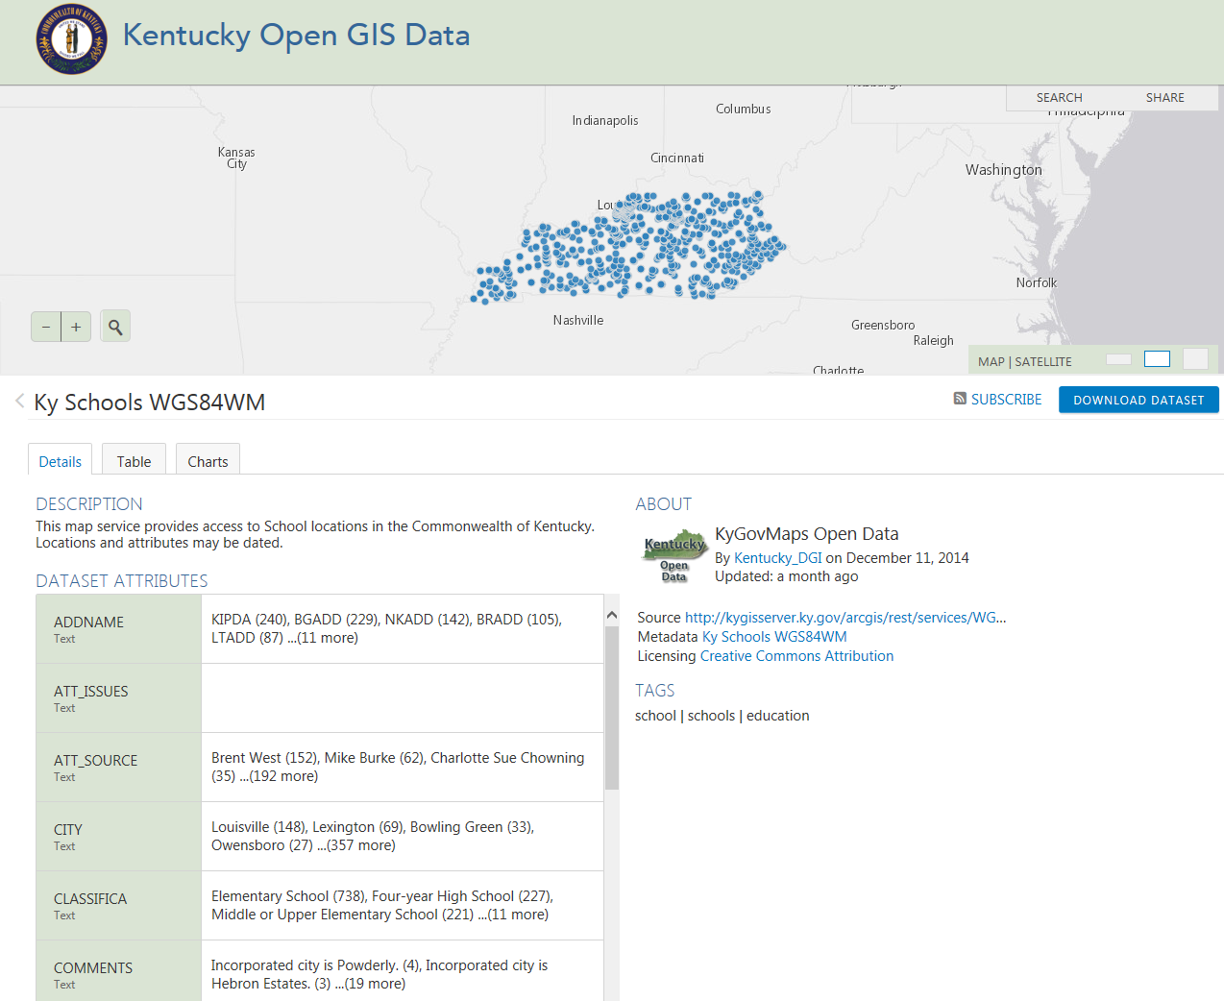
http://kygovmaps.kygeonet.opendata.arcgis.com/datasets/8aa43965adaf409e8966c6c16c79971c_0

Slide 20
EXAMPLE 1 - KYAPED – LiDAR DEM
Aerial
Nominal Pulse Spacing 1 meter or better
About 70% of state covered
Conforms to USGS (and FEMA) standards
KY From Above partners get point cloud
5 foot DEMs are available to the public

Slide 21
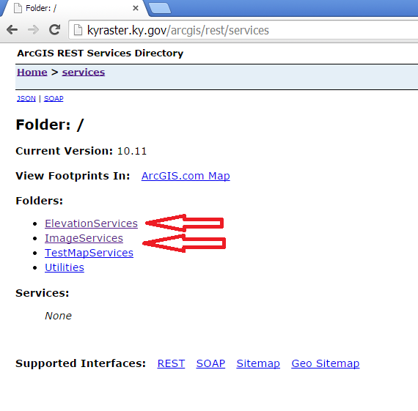
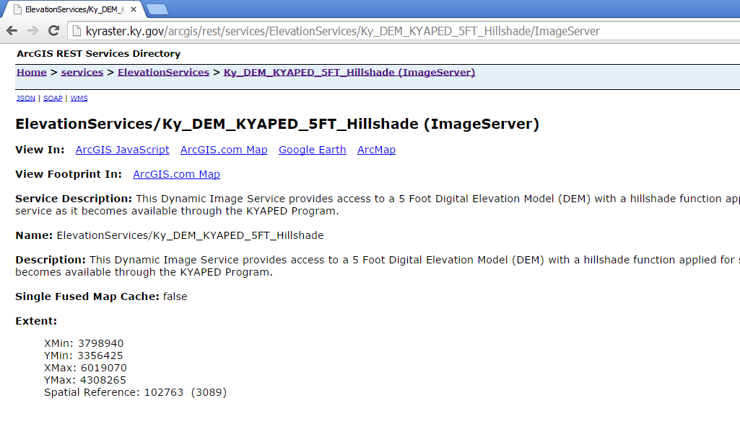

Slide 22
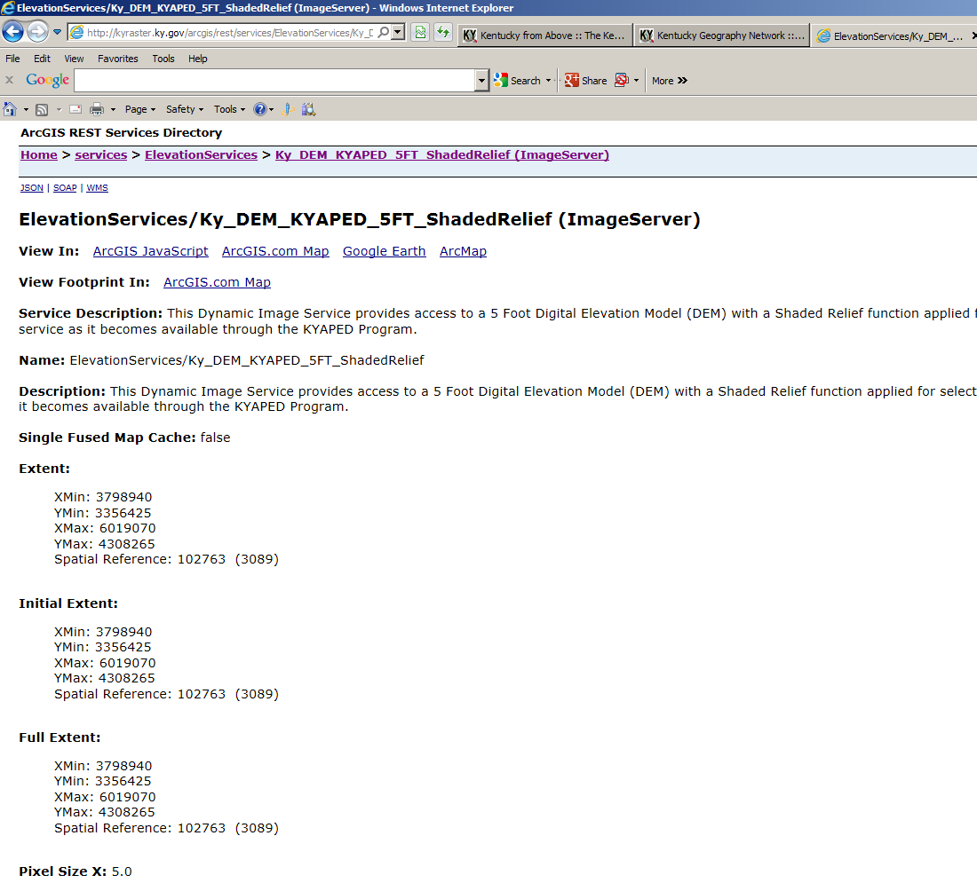
http://kyraster.ky.gov/arcgis/rest/services/ElevationServices/Ky_DEM_KYAPED_5FT_ShadedRelief/ImageServer

Slide 23
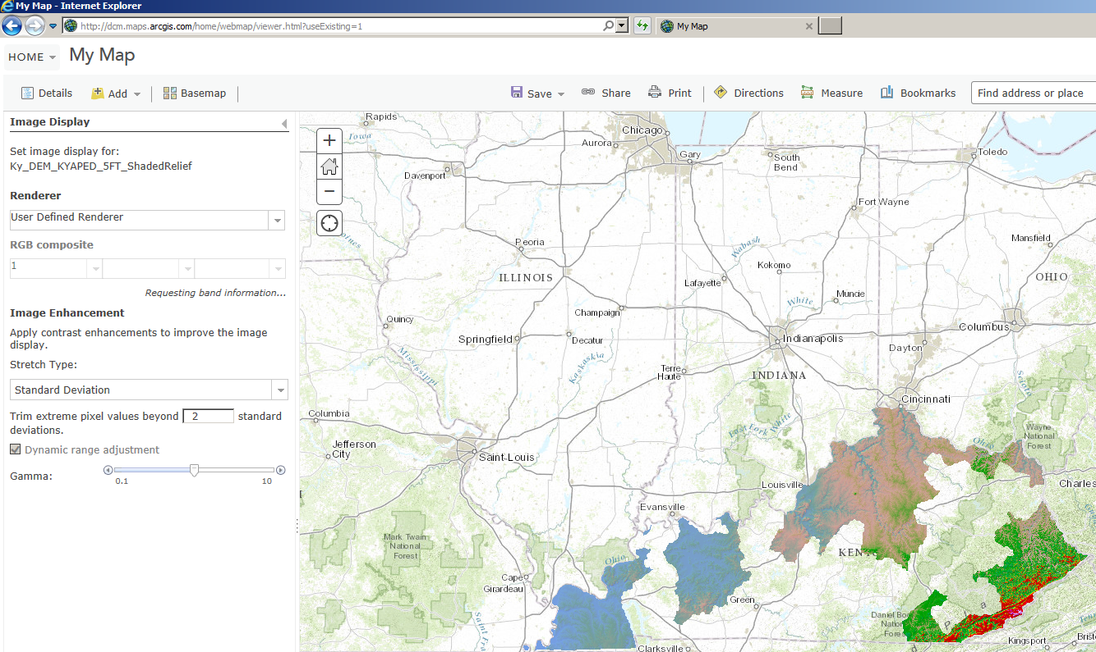
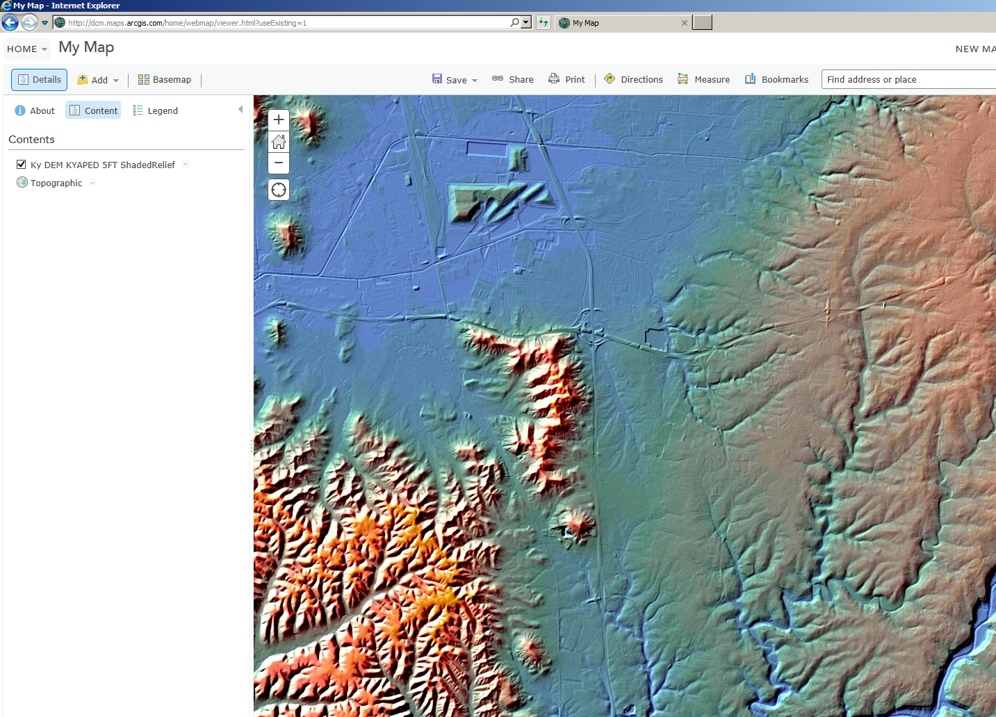

Slide 24
EXAMPLE 2: KYAPED – Aerial Multispectral Data
Aerial
Orthorectified – high quality, numerous GCPs
High spatial resolution (6 inch, 1 foot)
Standard spectral resolution (4 bands)
Standard radiometric resolution (8-bit depth)
Episodic revisits (funding dictates frequency!)
Spatial accuracy: meter-range

Slide 25
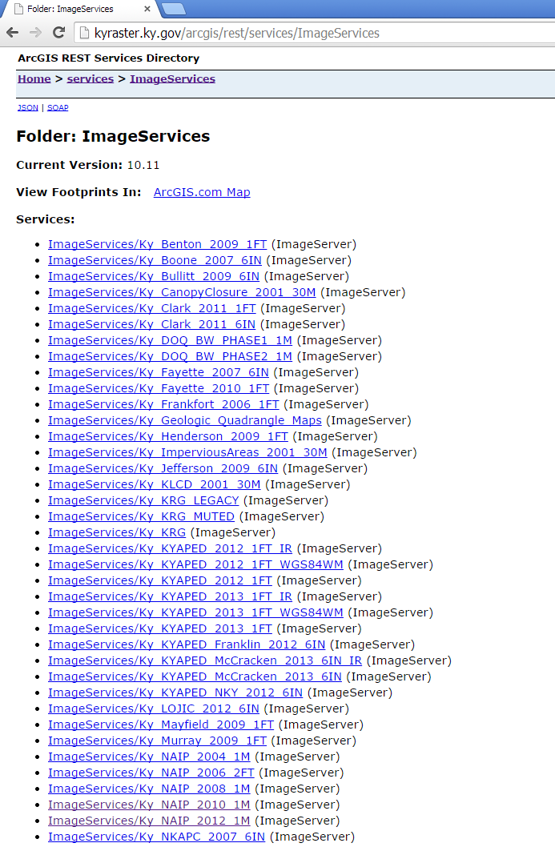

Slide 26
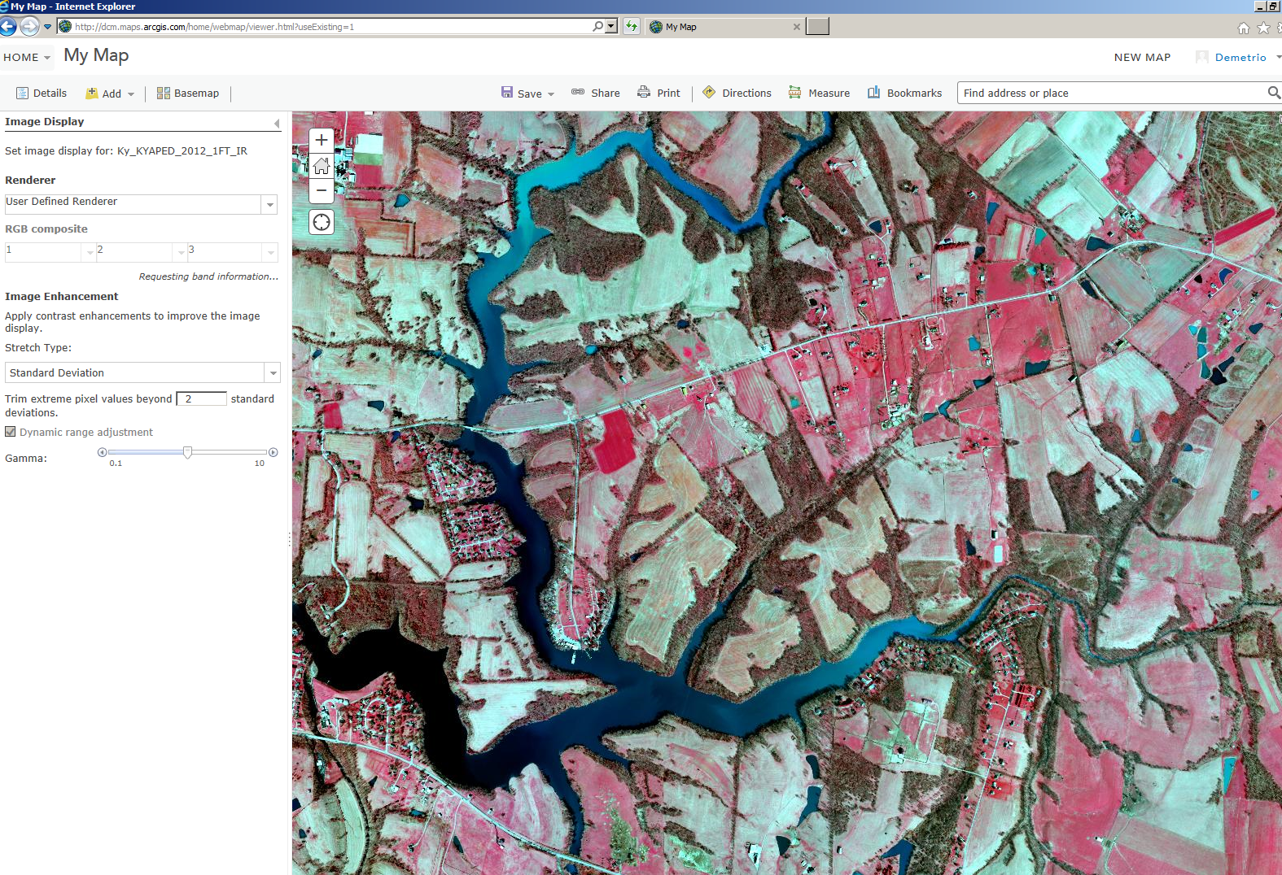

Slide 27
EXAMPLE 3: NAIP (multispectral)
Aerial
Orthorectified – high quality, numerous GCPs
High spatial resolution (1 meter)
Standard spectral resolution (4 bands)
Standard radiometric resolution (8-bit depth)
Periodic revisits (every two years)
2004, 2006, 2008, 2010, 2012, 2014
Spatial accuracy: meter-range

Slide 28
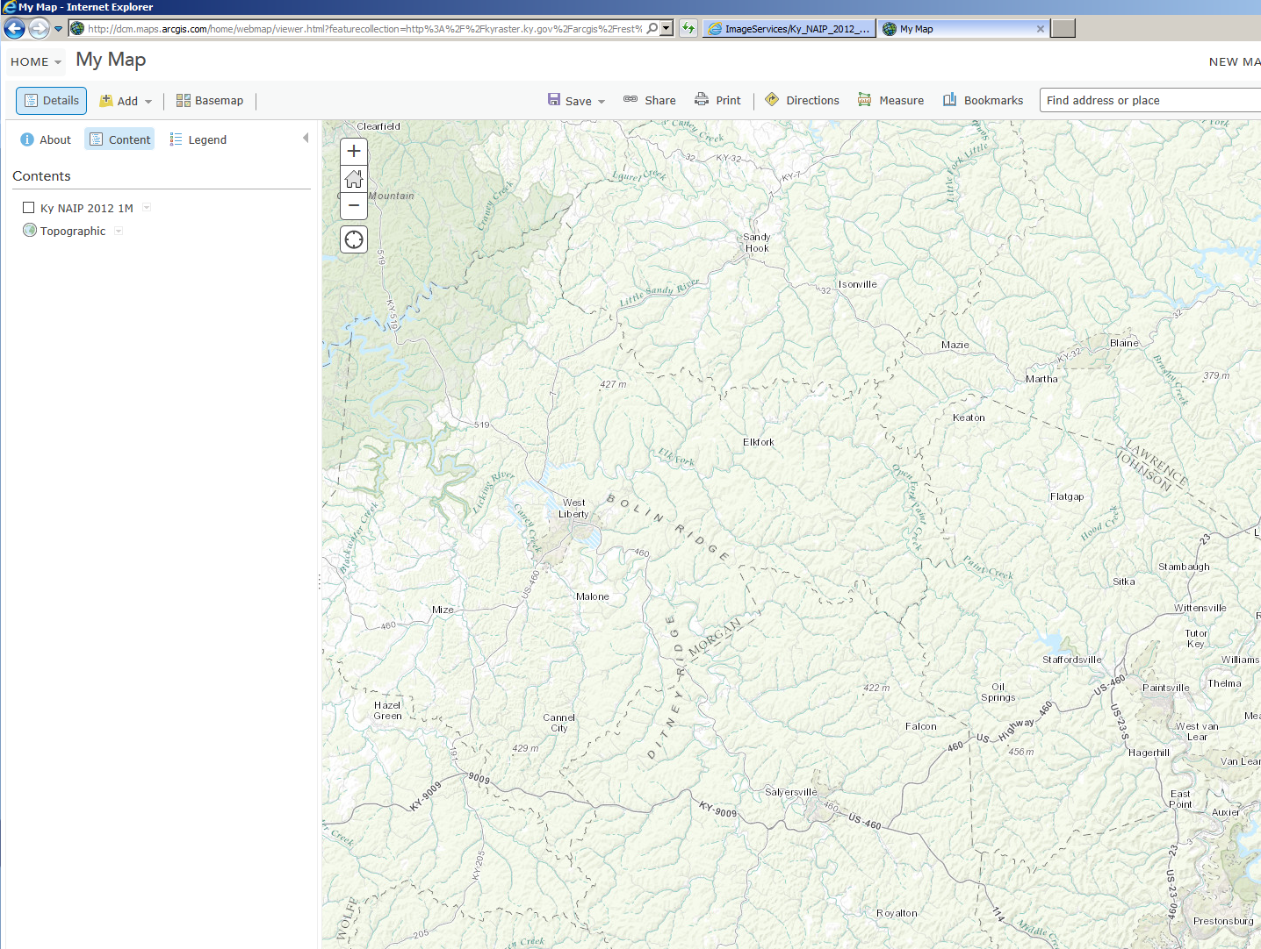
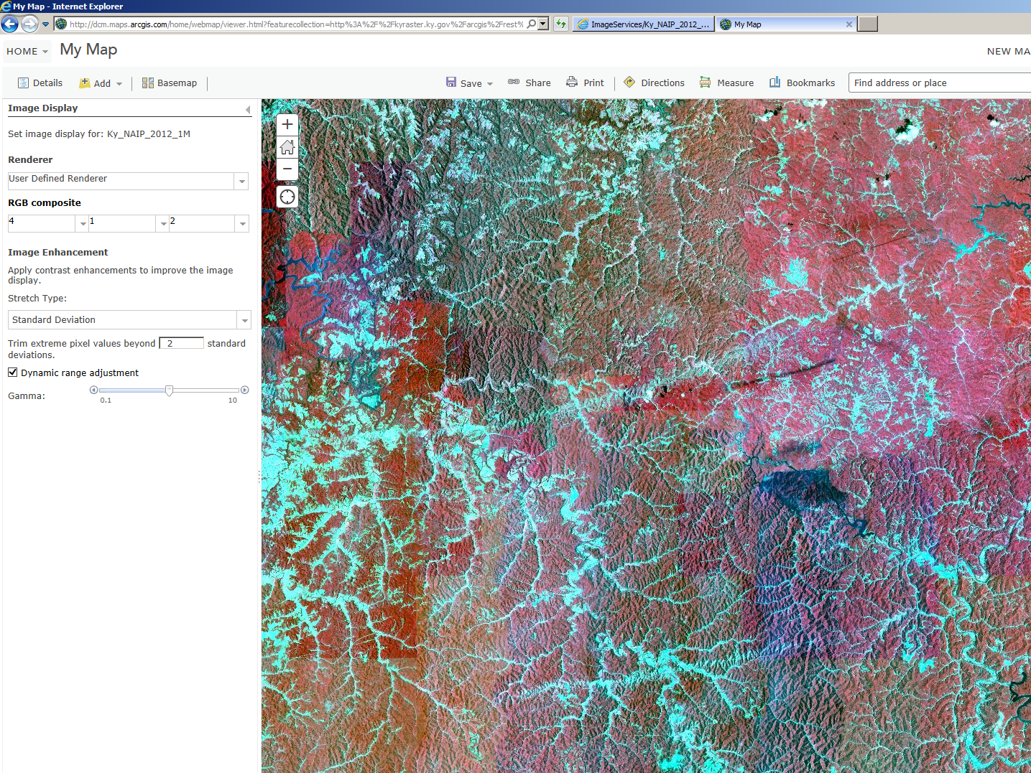

Slide 29
EXAMPLE 4: Story Maps

Slide 30
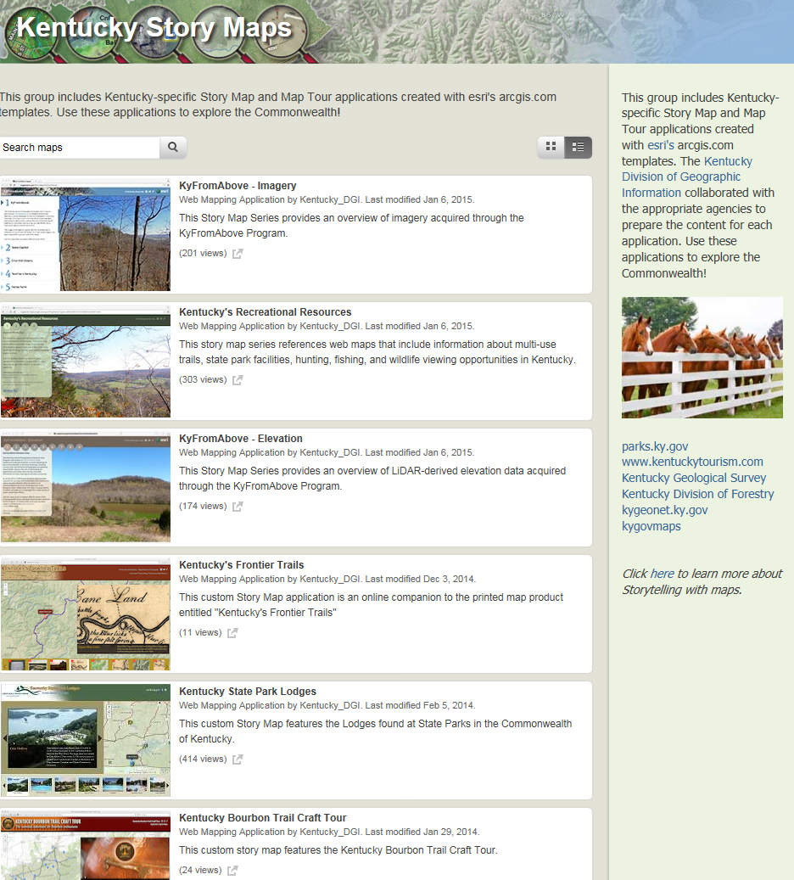
http://kygeonet.ky.gov/govmaps/KyStoryMapsGallery/

Slide 31
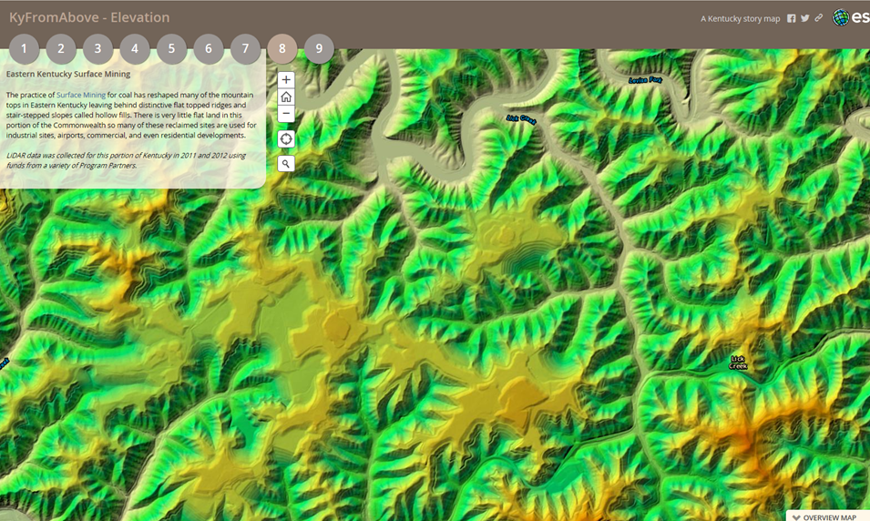
http://kygeonet.ky.gov/StoryMaps/KyFromAboveElevation/

Slide 32

http://kygeonet.ky.gov/StoryMaps/KyBourbonTrailCraftTour/#

Slide 33
EXAMPLE 5: Crowdsourcing/Data Mining/Mobile GIS

Slide 34












Other Existing Cloud (Real-Time) Resources:
Weather, Traffic, Cameras…etc
Web Maps & Dashboards for
Desktop & Mobile Devices
KYTC ArcGIS Online
WAZE
RWIS
TRAFFIC LIGHTS
AVL
OTHER…
Real-Time Data Feeds
Alerts/
Notifications
ArcGIS Server
GeoEvent Processor
Tableau (Reporting)
Real Time
SQL Database
Hadoop (Big Data)
Post Processed
Chris Lambert & Jeremy Gould - Kentucky Transportation Cabinet January 15, 2015

Slide 35

Questions?
Thank you.
Contact Information:
Demetrio P. Zourarakis
demetrio.zourarakis@ky.gov
502-564-6246
http://gis.ky.gov

